Slide 1
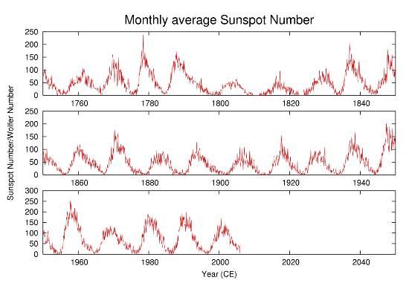
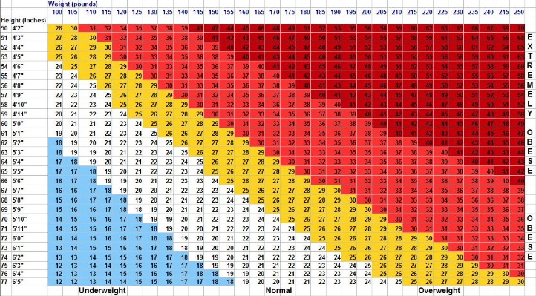
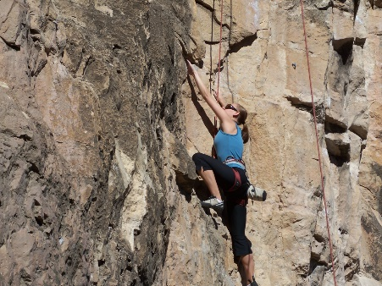
Feel free to change the color, font, layout. Please save this as a 1-page PDF and send to the office.
Your picture
Given Name Family Name
PhD Candidate
Department of XXXXXX, School of XXXXX, University of XXXX
About your research topic, your lab…etc.
About your hometown, hobbies, interests…etc.

